Slide 1
Basic Details of the Team and Problem Statement
Ministry/Organization Name/Student Innovation:
Machine learning with python
Problem Statement Title : Duplicate question pair
Team Leader Name: Abhijit Shaw
Institute Code: 108 Institute Name: ASANSOL ENGINEERING COLLEGE
Theme Name: To find duplicacy during examination and in multiple file as well as pdf and documents

Slide 2
Team Member Details
Team Member1 Name (Team Leader): Abhijit Shaw
Branch : B.tech Stream : IT Year (I,II,III,IV): III
Team Member 2 Name: NISHA JHA
Branch :B.tech Stream : IT Year (I,II,III,IV ): III
Team Member 3Name: Amit Kumar Singh
Branch :B.tech Stream : IT Year (I,II,III,IV ): III
Team Member 4 Name: Agnishwar Mukherjee
Branch : B.tech Stream: IT Year (I,II,III,IV ): III
Team Member 5 Name: J Srikant chetty
Branch : B.tech Stream: IT Year (I,II,III,IV ): III

Slide 3
Idea/Approach Details
Describe idea/Solution/Prototype here:
Duplicate question pairs refer to pairs of questions that are very similar in their meaning or intent, often differing only in their wording or phrasing. These pairs may arise when multiple users ask the same or similar questions in online forums, search engines, or question-answering systems. Identifying and managing duplicate question pairs can be important in improving the quality and efficiency of such systems, as it allows users to find relevant information more easily and avoids duplication of effort in answering the same questions repeatedly.
The objective for this project is to develop a machine learning model that can accurately identify whether a pair of questions are duplicates or not. This task can be important in various applications such as question-answering systems, search engines, and online forums where users may ask similar questions repeatedly.
Describe Technology stack here:
Python
Numpy
Pandas
seaborn
Matplotlib
Sklearn
t-Distributed Stochastic Neighbor Embedding (t-SNE) (for graph )
Nltk (Stopwords )
Xgbclassifier in Xgboost

Slide 4
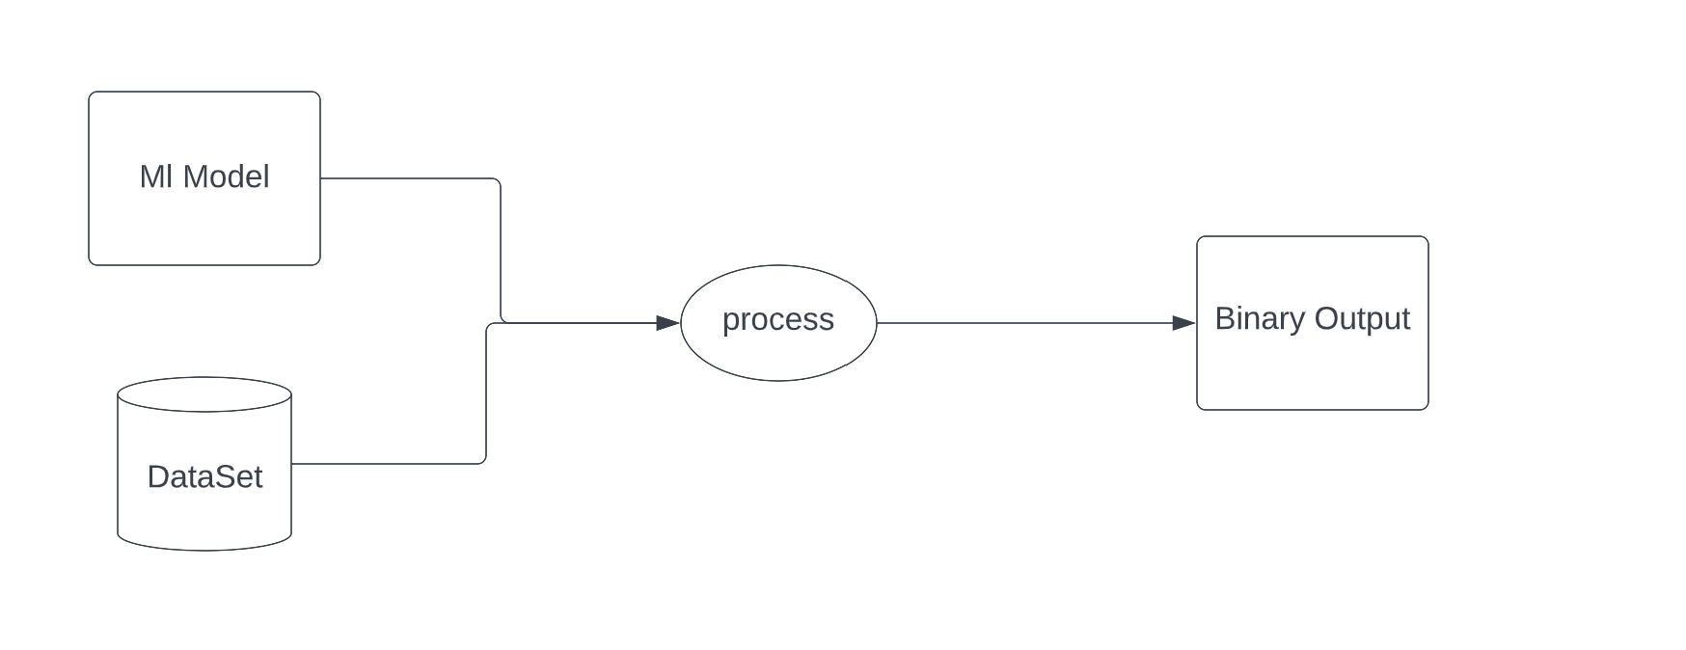
Approach Diagram

Slide 5
Describe your Use Cases here
It saves the question asker time if their question has already been answered previously on the site. Instead of waiting minutes or hours for a response, they can get their answer immediately.
Frequently repeated questions can frustrate highly engaged users whose feeds become polluted with redundant questions. Many users who answer questions in a particular topic see slight variations on the same question appearing many times in their feed, and this creates a negative user experience for them.
• Q&A knowledge bases have more value to users and researchers when there is a single canonical question and collections of answers, instead of having the knowledge fragmented and spread throughout the site. This reduces the time it takes for users to find the best answers, and allows researchers to better understand the relationship between questions and their answers.
• Having knowledge of alternative phrasings of the same question can improve search and discovery. Full text search is a valuable feature of Q&A sites, but its utility is limited by needing to query for near-exact question phrasing. Having multiple representation of the same question can improve this search process significantly for users.

Slide 6
Experiments
The dataset used for this analysis was provided by Quora, released as their first public dataset as described above. It consists of 404352 question pairs in a tab-separated format ,
1. The Token features are as follows : -
• id: unique identifier for the question pair (unused)
• qid1: unique identifier for the first question (unused)
• qid2: unique identifier for the second question (unused)
• question1: full unicode text of the first question
• question2: full unicode text of the second question
• is_duplicate: label 1 if questions are duplicates, 0 otherwise
Cwc_min : This is the ratio of no. of common words to the length of smaller questions .
Cwc_max: This is the ratio of no. of common words to the length of larger questions .
Csc_min: This is the ratio of no. of common stopwords to the smaller stopword count among the 2 questions .
Csc_max: This is the ratio of no. of common stopwords to the larger stopword count among the 2 questions .
Ctc_min: This is the ratio of the number of common tokens to the smaller token count among the two tokens .
Ctc_max:This is the ratio of the number of common tokens to the larger token count among the two tokens .
Last_word_eq: 1. if the last word in the two questions is same ,0 otherwise
First_word_eq: 1. if the first word in the two questions is same ,0 otherwise

Slide 7
Experiments
2. Length Based Features :
Mean_len: Mean of the length of two questions (no. of words )
abs_len_diff: Absolute difference between the length of two questions( no. of words )
Longest_substr_ratio: Ratio of the length of the longest substring among the two questions to the length of the smaller question .
3. Fuzzy Features :
fuzz_ratio: Fuzz ratio score from fuzzywuzzy
fuzz_partial_ratio: Fuzz _partial_ratio from fuzzywuzzy
Token_sort_ratio: Token_sort_ratio from Fuzzywuzzy
Token_set_ratio: Token_set_ratio from fuzzywuzzy

Slide 8
Of the over 400K question pairs, 149302 are duplicates, or roughly 37% of the full dataset. A few notes on the sampling methodology used to generate the dataset. Quota has stated that the distribution of duplicates is not representative of questions across the site, which would result in a vanishingly small proportion of duplicates if questions were paired uniformly at random. Instead, negative samples are drawn from a pool of “related questions” that are similar in terms of word and phrase composition, but not classified as duplicates. Similarly, duplicate questions are drawn from the set of “merged questions” that have been human curated as duplicates. Because a single human user can choose to merge or not merge questions without moderator approval, there’s inherently some amount of noise in the labels. In preprocessing the data for this task, we removed some 2413 question pairs of which 1157 were labeled duplicates. Specifically, we removed all question pairs whose combined word count across both questions was under 10 characters, as these questions tended to be nonsensical. We also removed any question pairs where at least one of the questions was over 59 words in length, as these tended to be long diatribes with very personal details, unlikely to be duplicated. This truncation allowed the model to be more efficient to train, but it would be worth investigating in the future ways of allowing these longer questions to be included in the dataset. For example, LSTMs can handle dynamic sequence lengths, and for CNNs we could consider simply truncating the questions that exceed our threshold.

Slide 9
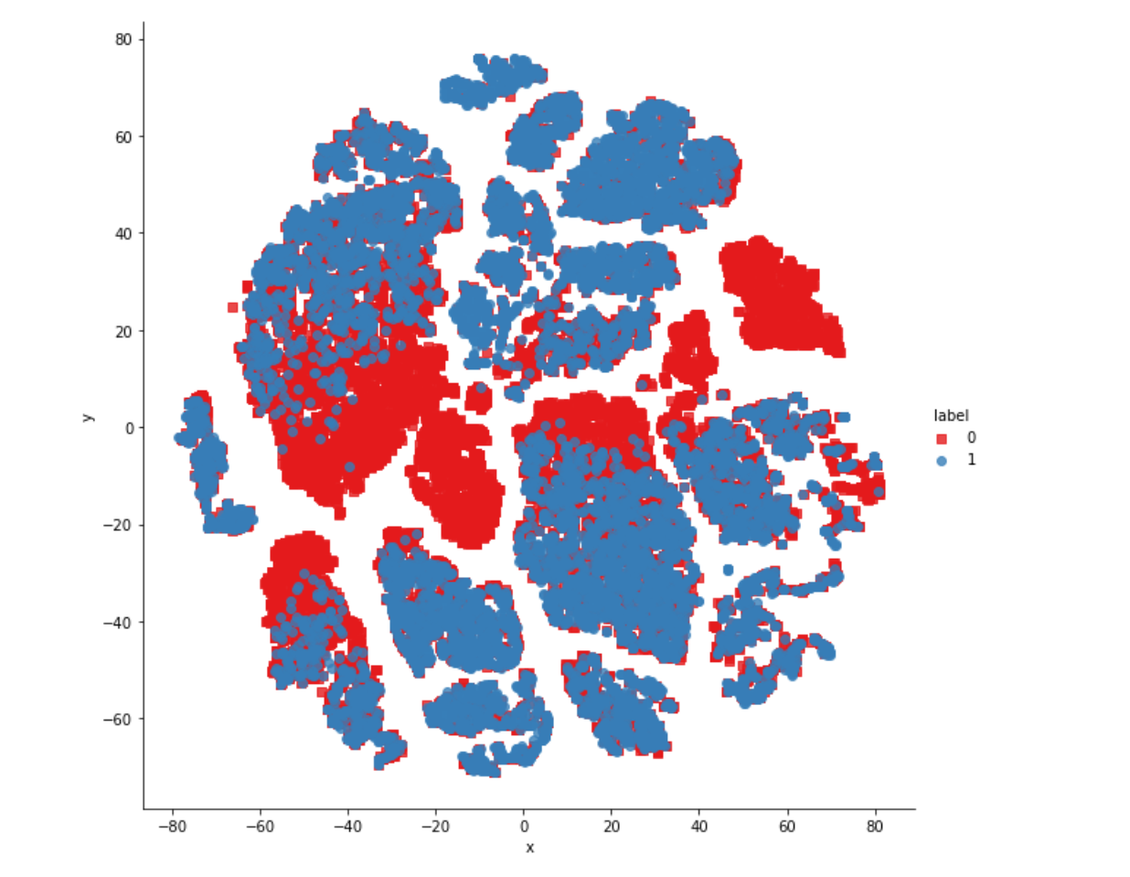
RESULTS
We will take questions from the given data set and will apply machine learning concept on them if the data set found duplicacy it will return with binary number 1 and if not found duplicate it’ll return with binary number 0.
Different functions will return different values from dataset like :

Slide 10
CONCLUSION
Machine learning methods clearly outperform the baselines for the task of duplicate question pair detection. The siamese network architecture achieved a 7% performance gain over a simpler multilayer perceptron architectures, and a 14% gain over the shingling method. The LSTM method had comparable and slightly better performance than the CNN, but was much faster to train. A hybrid model combining both the LSTM and the CNN together produced no noticeable performance gain, but was much slower to train overall. Using the general siamese network architecture provided good results, and the multilayer perceptron combination layer had success at combining the two feature vectors together. In terms of possible extensions to the model, we suspect that using word embeddings trained on Quora data could provide a boost in performance. Perhaps most promising, however, is the idea of moving away from a siamese network architecture towards the multi-perspective matching described by Wang et al.. It would be interesting to find a way to achieve this combining of question features within a combined CNN layer. Overall, however, it’s clear that deep learning is a powerful tool when applied to this problem that shows a lot of promise going forward

Slide 11
Future Scope
We are using BOW (bag of words )for sampling of our dataset which gives us a lack in semantic
In spite of that we can use w2v (Word2Vec) . The purpose and usefulness of Word2vec is to group the vectors of similar words together in vectorspace. Which will increase semantic meaning of our model
Our model is based on accuracy giving binary result as 0 and 1
1 – Stands for Duplicacy
0 –non-duplicacy
Instead of that we can use metric logloss to return fractional result
Everytime we are getting 0 and 1 from our model to get result we can also set a threshold ( between 0 and 1 ) to increase the speed and accuracy .
Later on we will make a webpage on this approach to get a better GUI of our model and easy to access for users .

Slide 12
THANK YOU

